Slide 1
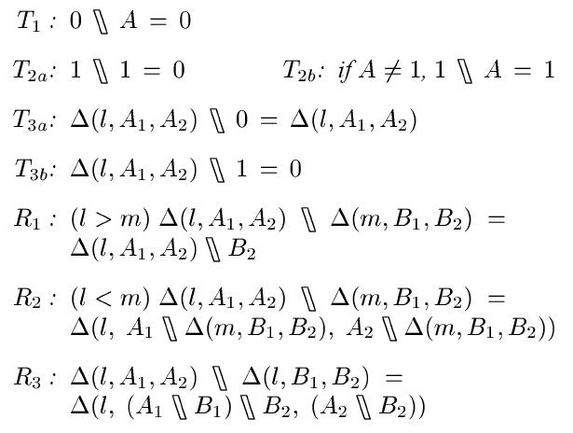
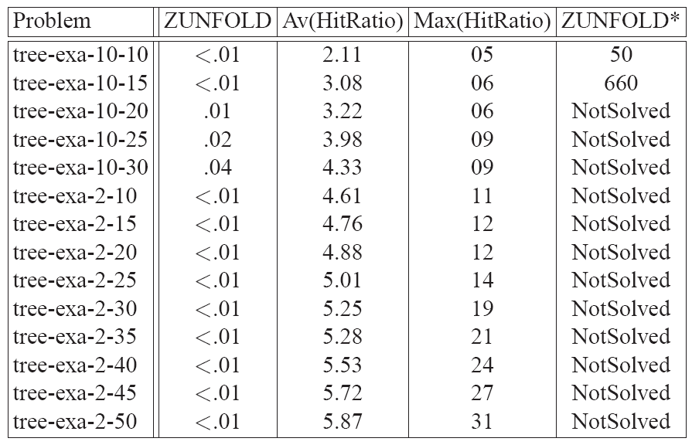
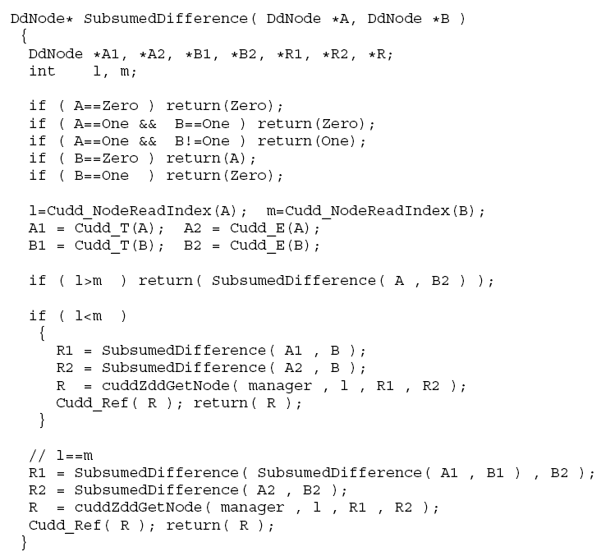
An Operator for Removal of Subsumed Clauses‌
Mohammad Ghasemzadeh and Christoph Meinel
Yazd University and HPI at the University of Potsdam in Germany
Introduction
The formal verification problem is strongly correlated with the SAT and the QSAT problems. One approach in solving SAT and QSAT problems is based on using ZDD (Zero-Suppressed BDD) which is a variant of BDD (Binary Decision Diagram). When working with clauses, very often a big number of clauses are subsumed by other clauses. In such situation one may remove the subsumed clauses to simplify the formula. In this paper we reintroduce an operator for removing subsumed clauses, then we show how removing subsumed clauses may affect the efficiency of ZUNFOLD which is our 'Unfolding' based QSAT solver.
Subsumed Clauses
In SAT and QSAT problems when we are working with CNF formulas, in order to prune the search space, variables which can get only one value must be assigned and be removed from the formula. A unit clause is a clause with exactly one literal. For example in:
f=(a ∨ ¬b ∨ ¬c) ∧ (a ∨ ¬c ∨ d) ∧ (b) ∧ ( a ∨ b ∨ c) the third clause is a unit clause. Since the algorithm tries to satisfy the formula, the variable appearing in a unit clause can essentially get one of the truth-values. In the above example, b can only receive the value true, which lets f be simplified to:
f₁=(a ∨ ¬c) ∧ (a ∨ ¬c ∨ d).
In f₁ the first clause subsumes the second clause. In other words, if an assignment satisfies the first clause then it will surely satisfy the second clause too. In such cases the subsumed clause(s) can be removed. In order to remove such subsumed clauses we need to define an operator for subtraction of the subsumed clauses. A formulation for this kind of subsumed difference can be seen below:
Quantified Boolean Formula
Quantified Boolean formula (QBF) is an extension of propositional formula (also known as Boolean formula). A Boolean formula like (x ∨ (¬y → z)) is a formula built up from Boolean variables and Boolean operators like conjunction, disjunction, and negation. In quantified Boolean formula, quantifiers may also appear in the formula, like in ∃x (x ∧ ∀ y (y ∨ ¬ z)). The ∃ symbol is called existential quantifier and the ∀ symbol is called universal quantifier. ZUNFOLD is our already published QBF evaluator which is based on ZDD and unfolding. We added the above operation to investigate its effects.
Results
We examined ZUNFOLD to find out the effect of including the NoSub operation. Therefore we evaluated it by different benchmarks from QBFLIB website. In order to investigate the effect of including / excluding the NoSub operation, we run it with/without the operation. Table 1 show the results of this experiment over LET's benchmarks. The third column titled Av(Ratio)' stands for ''average of ratio''. Here ratio is the size of the ZDD before and after applying the NoSub operation. We can see the ratios rise as the size of the benchmark problem rise. This indicates that NoSub helps more when instances of the QSAT go larger. The last column in the table shows that ZUNFOLD could only solve very small instances of QSAT when the NoSub operation was excluded.
Table 1: Effect of the NoSub operation on ZUNFOLD
BDD/ZDD and ZUNFOLD
Ordered binary decision diagram and its variants are data structures which have shown to be very useful in implementation of verification tools. While BDDs are better suited for representing Boolean functions, ZDDs are better for representing sets. If we consider the variables appearing in a QBF as a set then the matrix of the QBF (which is a Boolean formula in CNF) can be viewed as a set of subsets. This is the motivation for using ZDD to represent and process QBF formula. This idea has already been used in a number of related works. In ZUNFOLD we adopted and implemented the unfolding algorithm to be suitable for working with ZDD.
Implementation / CUDD
The CUDD - Colorado University Decision Diagram - package provides functions to manipulate Binary Decision Diagram, Algebraic Decision Diagram, and Zero-suppressed Binary Decision Diagram. We implemented the above operator i n CUDD. A part of our code can be seen below.
Encoding Boolean Functions with BDD/ZDD
A BDD or more precisely ROBDD is a directed acyclic graph with labeled nodes, a unique source node, and such that each node is either a sink node or an internal node. An internal node can be denoted by Δ(x, n₁, n₂ ) where x is the label and n₁, n₂ stand for its two children. The main advantage of using BDD/ZDD for encoding a propositional formula is that it can describe very large sets of models in a very com-pact way. However this requires the computation of the Shannon normal form of the formula, which could be very expensive.
Conclusion
We showed that using ZDD along with removal of subsumed clauses let us to imple-ment an unfolding based QBF evaluator (QSAT solver) that works efficiently even for large instances of the problem.

